Slide 1

Study Report
Fu Kangwei
2019.10.21

Slide 2
Core System Package

Slide 3
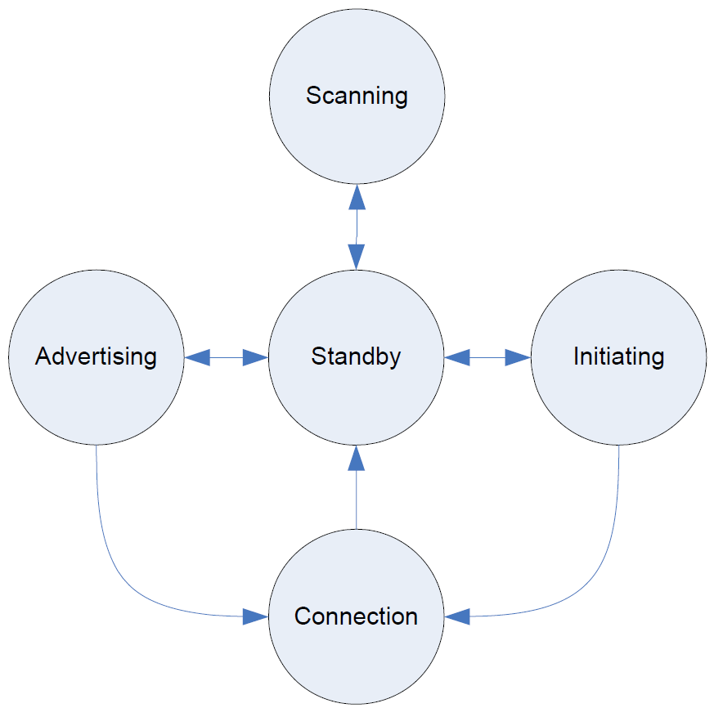
Link Layer
Standby
Advertising
Scanning
Initiating
Connection
Link Layer State
Devices are identified using a device address.
Devices addresses are 48 bits in length.
Public Device Address
Random Device address
Device Address Types
Static address
Private address

Slide 4
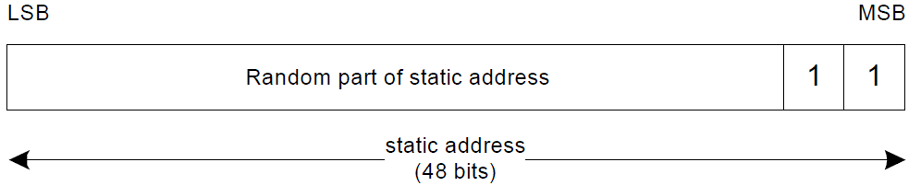
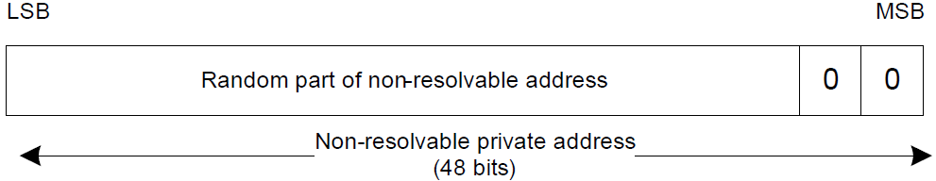
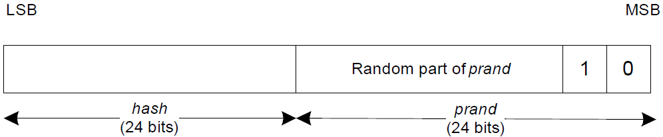
Random Device Address
Static Device Address
Non-resolvable Private Address
Resolvable Private Address

Slide 5
Physical Channel
40 RF channels are defined in the 2.4GHz ISM band.
Advertising
Periodic
Data
RF Channel
3 Primary Advertising Channels
37 Secondary Advertising Channels
Advertising
Primary Advertising Channel: Used for initial advertising and all legacy advertising activities.
Secondary Advertising Channel: Used for the majority of the communications involved.

Slide 6
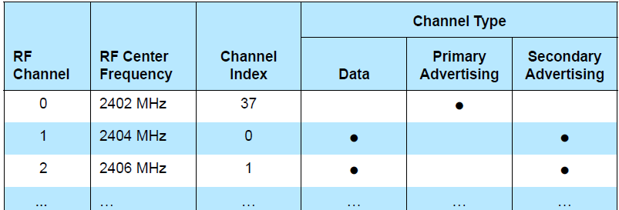
Physical Channel
Periodic physical channel: Use the same RF channels as secondary advertising channel.
Data physical channel:
  Use up to 37 RF channels for communication between connected devices.
  Each of these RF channels is allocated a unique channel index.
Mapping of PHY Channel to Channel Index and Channel Type

Slide 7
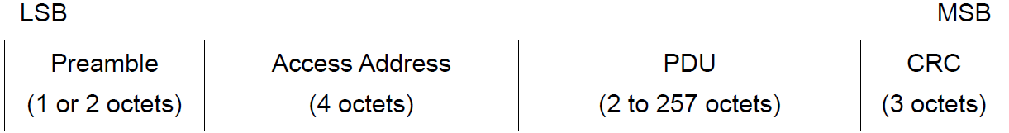
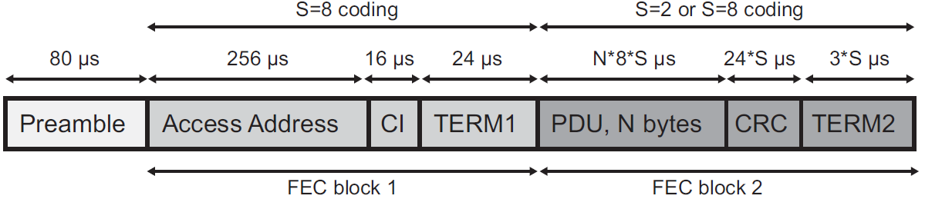
Physical Channel
Link Layer packet format for LE Uncoded PHYs: Used for both advertising channel packets and data channel packets.
Link Layer packet format for LE Coded PHY: Used for both advertising channel packets and data channel packets.

Slide 8
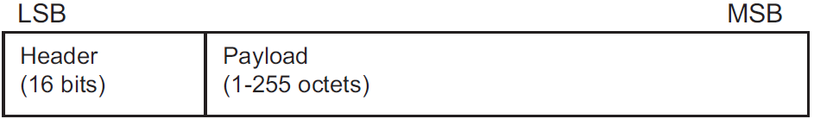
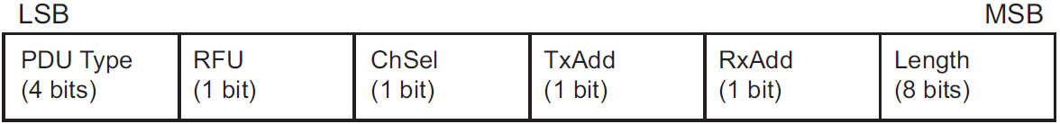
Advertising Channel PDUs
Advertising channel PDU
Advertising channel PDU Header
ADV_IND
ADV_DIRECT_IND
ADV_NONCONN_IND
ADV_SCAN_IND
ADV_EXT_IND
AUX_ADV_IND
AUX_SYNC_IND
AUX_CHAIN_IND
Advertising
PDUs
Sent by Link Layer in Advertising State.
Received by Link Layer in Scanning State or Initiating State.

Slide 9
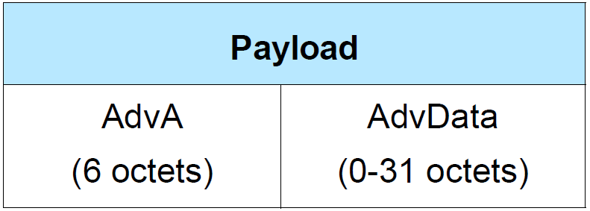
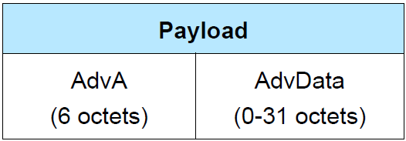
Advertising Channel PDUs
ADV_IND: connectable and scannable undirected advertising events.
ADV_DIRECT_IND: connectable directed advertising events.
ADV_NONCONN_IND: non-connectable and non-scannable undirected advertising events.
ADV_SCAN_IND: scannable undirected advertising events.
ADV_IND
ADV_NONCONN_IND

Slide 10
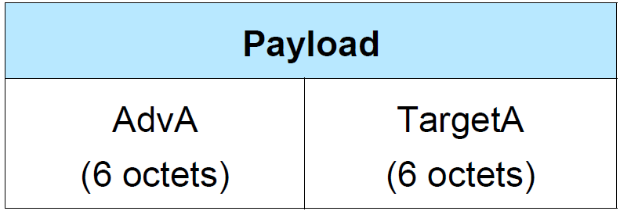
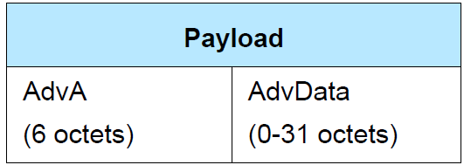
Advertising Channel PDUs
ADV_EXT_IND: all advertising events (except connectable and scannable undirected).
AUX_ADV_IND: all advertising events (except connectable and scannable undirected).
AUX_SYNC_IND: periodic advertising.
AUX_CHAIN_IND: hold additional AdvData.
ADV_DIRECT_IND
ADV_SCAN_IND

Slide 11
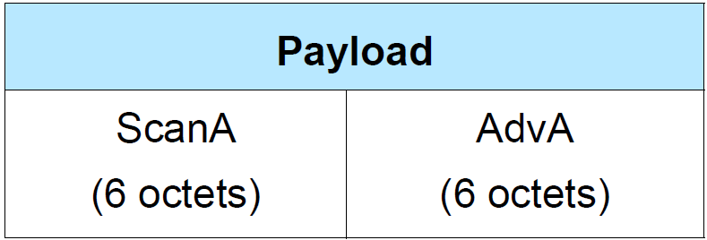
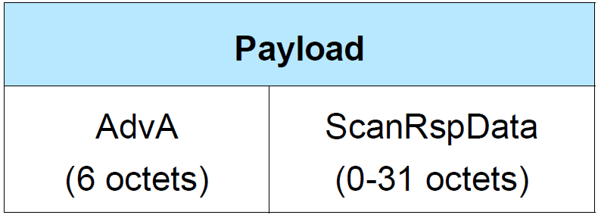
Advertising Channel PDUs
SCAN_REQ
SCAN_RSP
AUX_SCAN_REQ
AUX_SCAN_RSP
Scanning
PDUs
SCAN_REQ & AUX_SCAN_REQ: Called scan request PDUs.
SCAN_RSP & AUX_SCAN_RSP: Called scan response PDUs.
SCAN_REQ & AUX_SCAN_REQ
SCAN_RSP

Slide 12
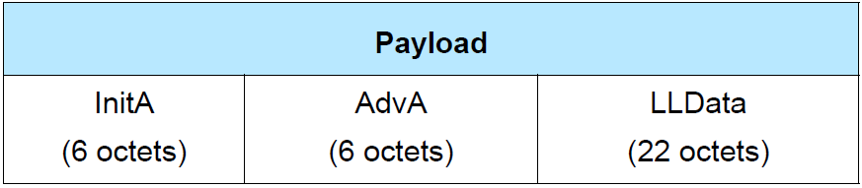
Advertising Channel PDUs
CONNECT_IND
AUX_CONNECT_REQ
AUX_CONNECT_RSP
Initiating
PDUs
CONNECT_IND & AUX_CONNECT_REQ:
  Sent by Link Layer in Initiating State.
  Received by Link Layer in Advertising State.
AUX_CONNECT_RSP:
  Sent by Link Layer in Advertising State.
  Received by Link Layer in Initiating State.
CONNECT_IND and AUX_CONNECT_REQ

Slide 13
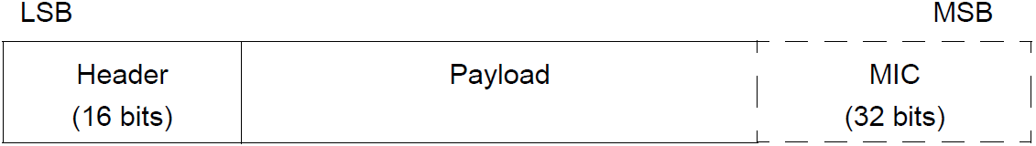
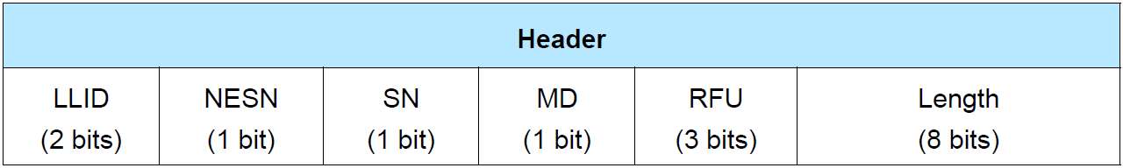
Data Channel PDU
Data Channel PDU
Data channel PDU header
MIC: Included in an encrypted Link Layer connection with a data channel PDU with a zero length Payload.
Payload: Its format depends on LLID of Header.
  If LLID is 01b or 10b, Payload contains LL Data PDU.
  If LLID is 11b, Payload contains LL Control PDU.

Slide 14
LL Data PDU
Data channel PDU that is used to send L2CAP data.
LLID in Header shall be set to either 01b or 10b.
If LLID in Header is set to 01b, Length is set to 00000000b, known as an Empty PDU.
If LLID in Header is set to 10b, Length is not set to 00000000b.

Slide 15
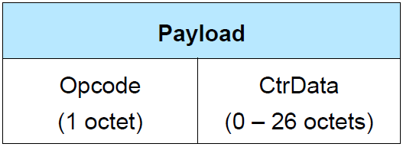
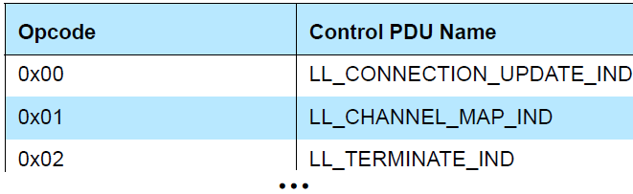
LL Control PDU
Data channel PDU that is used to control Link Layer connection.
Length is not set to 00000000b.
Opcode identifies different types of LL Control PDU.
CtrData in LL Control PDU is specified by Opcode.
LL control PDU payload
LL Control PDU Opcodes

Slide 16
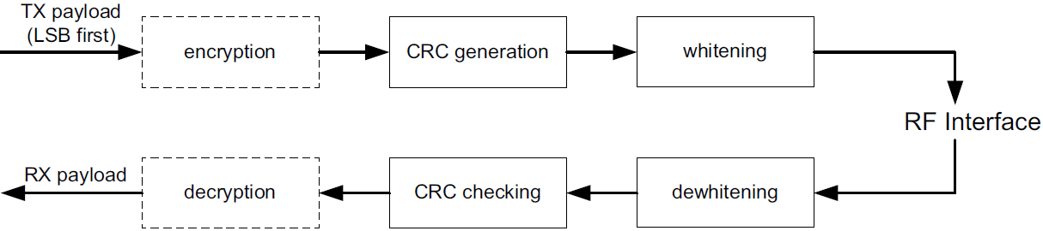
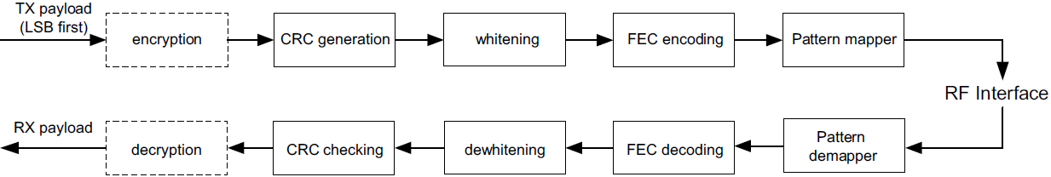
Bit Stream Processing
Payload bit processes for LE Uncoded PHYs
Payload bit processes for LE Coded PHYs

Slide 17
Error Checking
Receive the wireless packet.
Check Access Address.
If Access Address is incorrect, reject the packet.
If Access Address is correct, consider the packet received.
If CRC is incorrect, reject the packet.
If CRC is correct, considered the packet valid.

Slide 18
Error Checking
CRC shall be calculated on PDU in all Link Layer packets.
If PDU is encrypted, then CRC shall be calculated after encryption of PDU has been performed.
CRC polynomial is a 24-bit CRC.
The polynomial is shown as follows:

Slide 19
Data whitening & Coding
Data whitening is used to avoid long sequences of zeros or ones.
Data Whitening shall be applied on PDU and CRC of all Link Layer packets.
Data whitening: performed after CRC in transmitter.
De-whitening: performed before CRC in receiver.
Coding only applies to LE Coded PHY.
Coded by Forward Error Correction (FEC) convolutional encoder.
Spread by the pattern mapper.
Coding
Processes

Slide 20
Low Energy Link
Layer Security

Slide 21
Encryption & Authentication
Link Layer provides encryption and authentication using Counter with Cipher Block Chaining-Message Authentication Code (CCM) Mode.
CCM requires a new temporal key whenever encryption is started.
CCM requires a unique nonce value for each Data Channel PDU protected by a given temporal key.
CCM nonce shall be 13 octets.
CCM has 2 size parameters:
    M = 4: indicate that MIC is 4 octets.
    L = 2: indicate that Length is 2 octets.

Slide 22
Encryption & Authentication
CCM algorithm requires payload and some additional parameters to be formatted into CCM nonce, counter-mode blocks and encryption blocks.
CCM nonce: Provide uniqueness to each packet.
Counter-mode blocks: Used to calculate MIC.
encryption blocks: Provide the keystream that is used to encrypt payload and MIC of Data Channel PDU.
39-bit packetCounter
1-bit directionBit
8-octet IV (initialization vector)
CCM
nonce

Slide 23
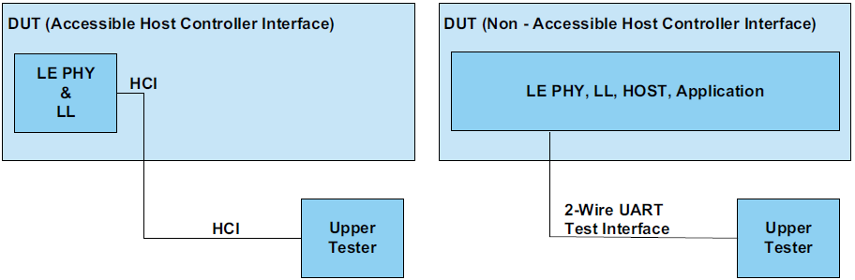
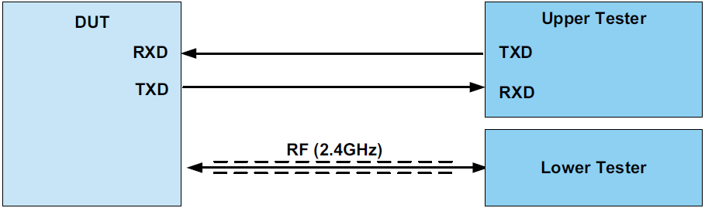
Direct Test Mode
Direct Test
Mode
Control the Device Under Test (DUT).
Provide a report back to the Tester.
Direct Test
Mode Method
Over HCI.
Through a 2-wire UART interface.
Designs with
accessible HCI
Design without
accessible HCI
UART control

Slide 24
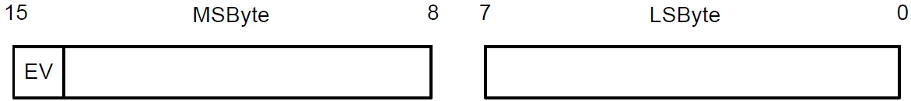
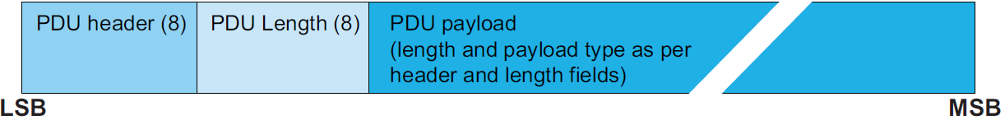
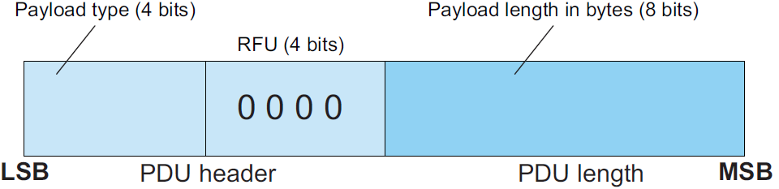
Direct Test Mode
LE_Test_Status_Event, EV = 0
LE_Packet_Report_Event, EV = 1
Two types of events
sent by DUT
LE test packets shall not use whitening.
CRC shift register shall be preset with 0x555555 for every LE test packet.
LE Test packet PDU structure
LE Test packet header and
length field structure

